Slide 1

Protocols and Layering

Slide 2
Communication Protocol
An agreement that specifies the format and meaning of messages computers exchange.
Application programs that use a network do not interact directly with the network hardware.
An application interacts with the protocol software that follows the rules of a given protocol when communicating.

Slide 3
Protocol Suite
Communication problem is divided into subpieces
Separate protocol is designed for each piece.
It is easier to design, analyze, implement and test a protocol.
Each protocol should handle part of the communication problem not handled by other protocols.

Slide 4
Protocol Suite (2)
They can share data structures and information.
Combination of the protocols should handle all possible hardware failures or other exceptional conditions.
To guarantee that protocols will work together, protocols are designed and developed in complete, cooperative sets called suites or families.
Each protocol in a suite solves one part of the communication problem, together they solve the entire communication problem.

Slide 5
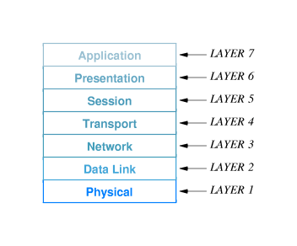
ISO 7-Layer Reference Model (1)
Layer 1: Basic Network Hardware
Layer 2: How the data is organized into frames and how to transmit frames over the network.
Layer 3: How addresses are assigned and how packets are forwarded from one end of the network to another.

Slide 6
ISO 7-Layer Reference Model (2)
Layer 4: How to handle details of reliable transfer. They are among the most complex protocols.
Layer 5: How to establish a communication session with a remote system.
Layer 6: How to represent data.
Layer 7: How one particular application uses a network.

Slide 7
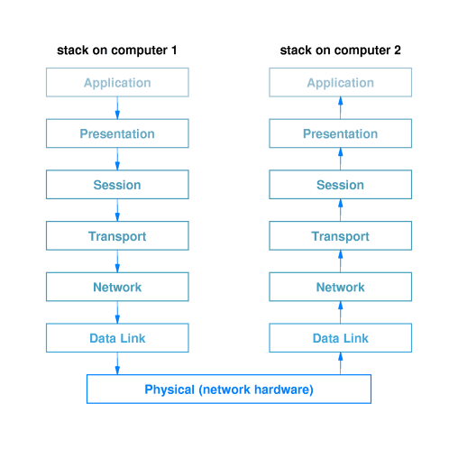
Conceptual Path

Slide 8
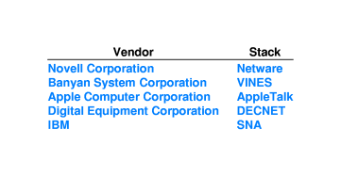
Examples of Protocol Stacks

Slide 9
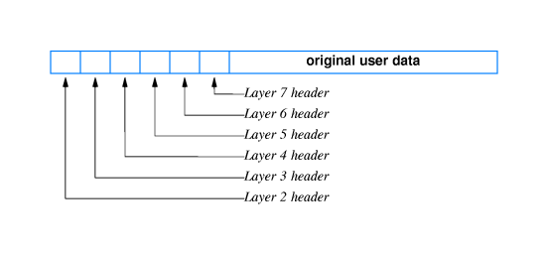
Multiple-Nested Headers

Slide 10
Techniques Protocols Use
Sequencing for Out-of Order Delivery
Sequencing to Eliminate Duplicate Packets
Retransmitting Lost Packets
Avoiding Replay Caused by Excessive Delay
Flow Control to Prevent Data Overrun
Mechanisms to Avoid Network Congestion

Slide 11
Flow Control Mechanisms
Sliding Window
Stop-and Go

Slide 12
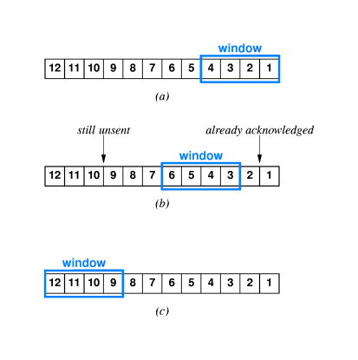
Sliding Window

Slide 13
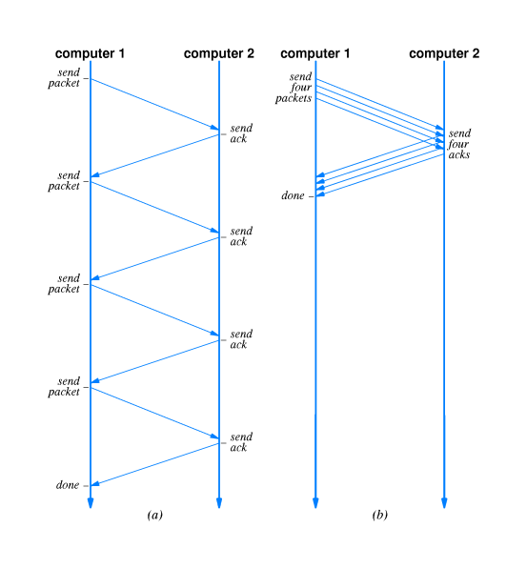
Stop-and Go vs Sliding Window

Slide 14
Performance of Sliding Window
T_{w} = T_{g} x W
T_{w} = min (B, T_{g} x W)

